Slide 1
Display Basics

Slide 2
Functions
Functions to be performed for displays
Output the appropriate display code
Output the code via right entry or left entry into the displays if there is more than one display

Slide 3
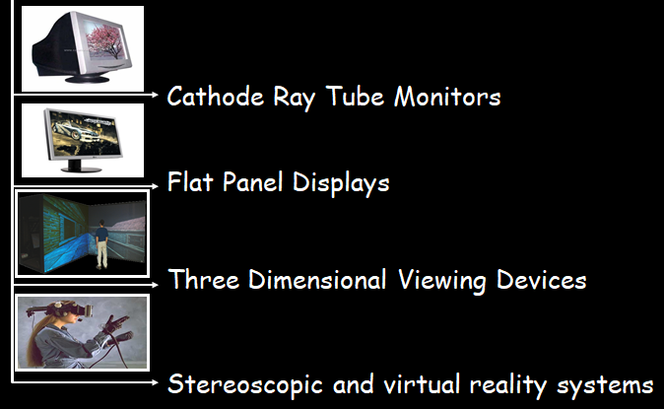
Types of Video Display Devices Available

Slide 4
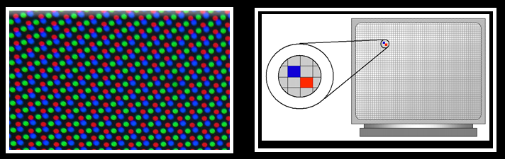
Terminology related to display devices
Pixel : A pixel or the picture element is the smallest item of information in an image. Graphic monitors display pictures by dividing the display screen into thousands of pixels arranged in rows and columns. Each image is made up of thousands of small pixels.

Slide 5
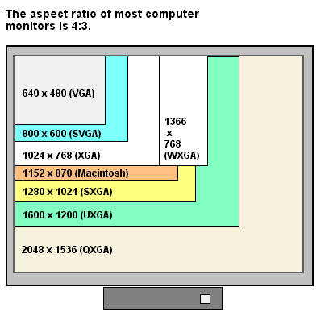
Terminology related to display devices
Resolution : Resolution is the number of distinct pixels in each dimension that can be displayed. More the resolution more clear is the image .

Slide 6
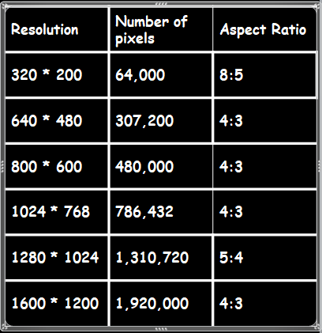
Terminology related to display devices
Aspect ratio of the image is the ratio of the number of X pixels to the number of Y pixels. The standard aspect ratio for a PC is 4:3. Displaying an image in a different aspect ratio displays the image somewhat distorted that is stretched lengthwise or widthwise.

Slide 7
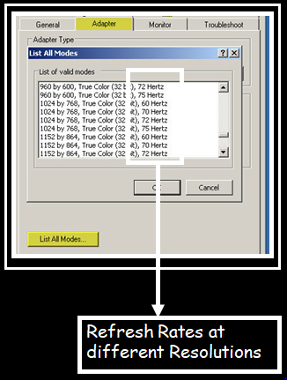
Terminology related to display devices
Refreshing : When dot of phosphor is struck by an electron beam it glows for some time and then fades away (persistence). In order to maintain a stable image the electron beam has to redraw the image number of times per second. This is refreshing. Normally in a CRT, the screen is refreshed 60 to 80 frames per second.

Slide 8
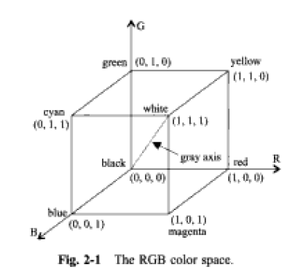

Slide 9
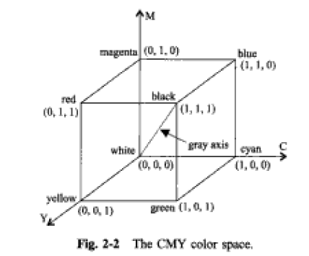
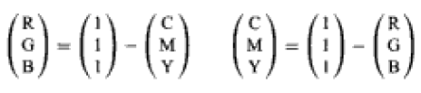

Slide 10
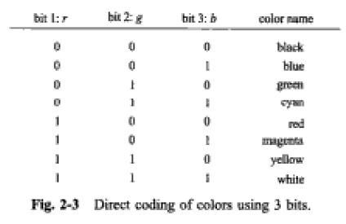

Slide 11
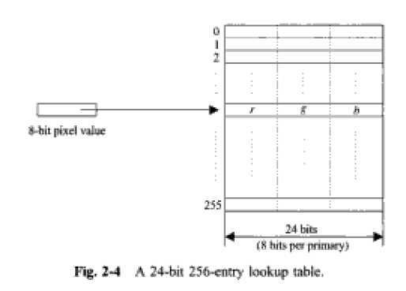

Slide 12
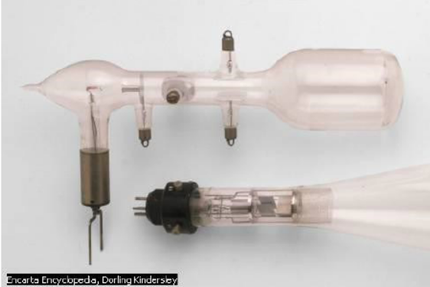
CRT Display
A CRT is a glass tube that is narrow at one end and opens to a flat screen at the other end.
CRT Structure:
Narrow end of CRT contains
a single electron gun for single-color monitor
Three electron guns for a color monitor—one each for three primary colors: red, green, and blue.
The display screen is covered with tiny phosphor dots.

Slide 13
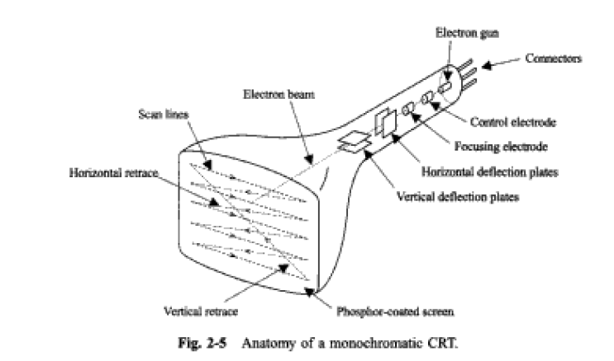

Slide 14
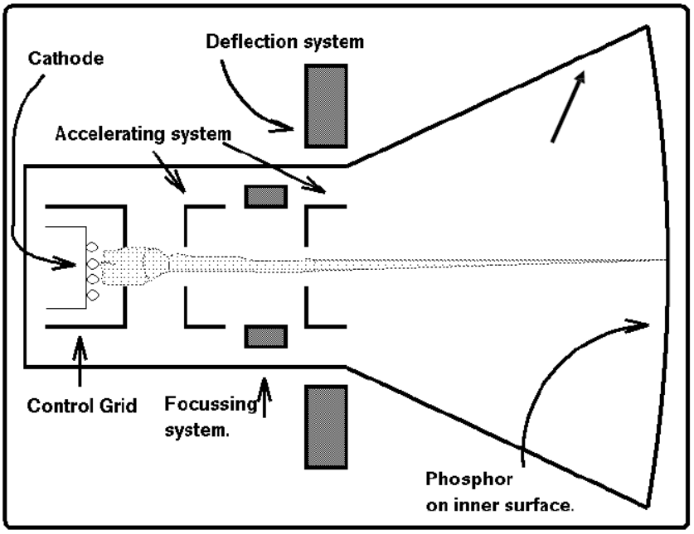

Slide 15
CRT Working Principle
CRT display works using :
Electron emission
Electrons are emitted from the Cathode tube.
Phosphorescence
It is the emission of visible light, when electron beam strikes Phosphor material.

Slide 16
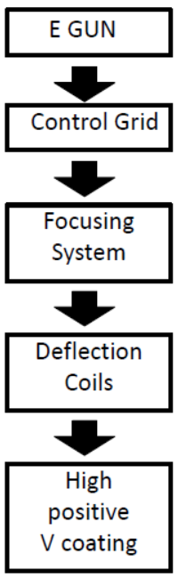
Components of CRT
Produces constant stream of electrons
Sets intensity of spot on screen (the more negative
the control grid voltage the fewer electrons pass
through)
Forces e-beam into narrow stream (otherwise repel)
Indicates target phosphor spot
15,000 - 20,000 V accelerates e-beam to screen

Slide 17
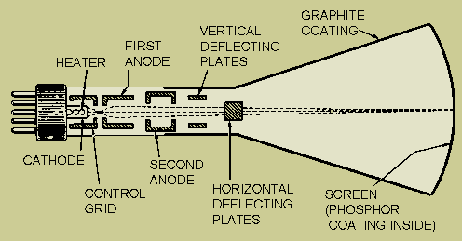
Working of a Cathode Ray Tube

Slide 18
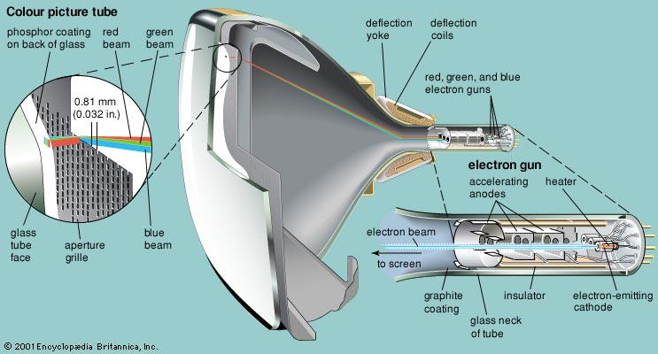
Working of a Cathode Ray Tube

Slide 19
Color CRT
CRT Monitor Displays color pictures by using a combination of phosphors that emit different colored light. Two Techniques for producing color Display with a CRT are:- Beam- Penetration Shadow Mask

Slide 20
Beam Penetration Method
Used with random-scan monitors, these systems have two layers of phosphor, green (the inner layer) and red (the outer one), are coated on to the inside of the CRT screen. The displayed color depends on how far the electron beam penetrates into the phosphor layers. It produces a limited number of colors red, orange, yellow and green. Inexpensive way of producing colors in Random Scan Picture Quality is not very good.

Slide 21
Shadow Mask Method
Commonly used in raster scan systems It can display a much wider range than Beam Penetration Method It has three phosphor color dots (red, green and blue) at each pixel position. These systems have three electron guns. One for each color dot. As per the picture definition the electron guns passes the electron beam which is properly deflected through the Shadow Mask hence forming a single beam.

Slide 22
Shadow Mask Method
When the beam passes through the Shadow mask. It activates the dot triangle. The phosphor dot triangle are so arranged that it activates it’s corresponding color dot when passes through the shadow mask

Slide 23

CRT Monitor Technology

Slide 24
Random Scan Displays (also known as Stroke-writing, Vector Or Calligraphic Displays)
When operated as random scan display unit, CRT has electron beam directed only to the parts of the screen where the picture is to be drawn. These system are used for line drawing (produces smooth line drawings) applications and cannot display realistic shaded scenes.

Slide 25
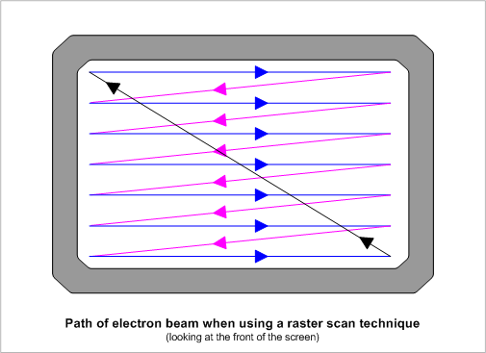
Raster Scan Display
Based on television technology , in these the electron beam sweeps across the screen one row at a time from top to bottom (scan lines swept by horizontal retrace and vertical retrace). As the electron beam sweeps the intensity is turned on or off as per the picture definition stored in the frame buffer to create a pattern of illuminated spots.

Slide 26
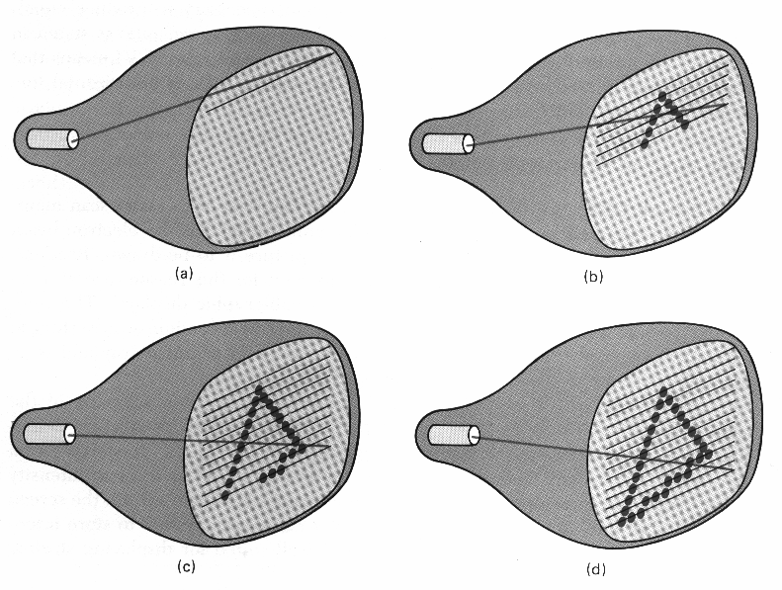
Raster Scan Display
Refreshing on raster scan is carried out at the rate of 60 to 80 frames per second.

Slide 27
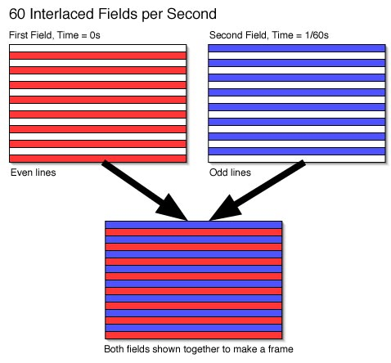
Interlaced Systems
In some raster system, interlacing technique is used for painting the screen . Instead of refreshing every line in an interlaced mode the electron gun sweeps alternate line in each pass (each frame is displayed in two frames odd numbered being refreshed first and then the even numbered lines.).
* This is an effective technique for avoiding flicker

Slide 28
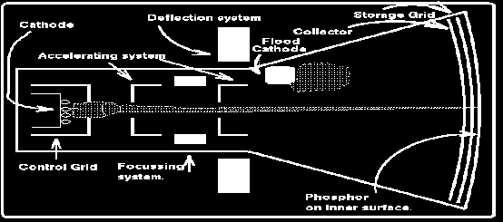
Direct View Storage Tube

Slide 29
Direct View Storage Tube
In all the earlier technologies we need refreshing of the screen An alternative method is Direct View Storage Tube. It stores the picture information as a charge distribution just behind the phosphor coated screen. Two electron guns primary gun and flood gun are used Primary gun stores the picture pattern and flood gun maintains the picture display

Slide 30
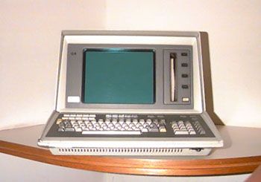
DVST vs Refresh CRT
In DVST since no refreshing required so complex pictures can be displayed at higher resolution without flicker. However DVST ordinarily does not display colors and parts of image cannot be erased here so not good for animation

Slide 31
CRT Display: Advantages and Disadvantages
Advantages:
Offers greater resolution .
Widest viewing angle when compared to any other technology.
It is cheap as compared to LCD,PLASMA displays.
Disadvantages:
Thickness is much larger as compared to LCD, PLASMA display.
Cannot be used for smaller displays like watches, calculators, portable devices.
View area is less than the offered monitor size.
It is more fragile and bulky.

Slide 32
Flat Panel Displays
Flat-Panel Display refers to a class of display devices that have reduced volume, weight and power requirements compared to CRT.
There are two categories of flat panel displays:
Emissive Displays
Non-Emissive Displays
Emissive Displays (or emitters) are devices that convert electrical energy into light. Plasma Panel (PDP) and light emitting diodes (LED) are examples of emissive displays.
Non-emissive displays ( or non-emitters) use optical effects to convert sunlight or light from some other source into graphics pattern e.g Liquid Crystal Display (LCD)

Slide 33
Liquid Crystal Display (LCD)
A liquid crystal display is a thin, flat display device made up of any number of pixels arrayed in front of a light source or reflector.
It uses very small amounts of electric power, and is suitable for use in battery-powered electronic devices.
Colour displays are possible by incorporating colour filters.
The heart of all liquid crystal displays (LCDs) is a liquid crystal itself. A liquid crystal is a substance that flows like a liquid, but its molecules orient themselves in the manner of a crystal.
That is, it is an organic compounds, whose macroscopic behavior resemble that of liquid but shows physical properties of crystals.
A plane has nematic-like structure, but with each plane molecules change their direction. As a result the molecules display a helical twist through the material.
They have characteristics like: rod-like molecular structure, or easily polarizable constituents.

Slide 34
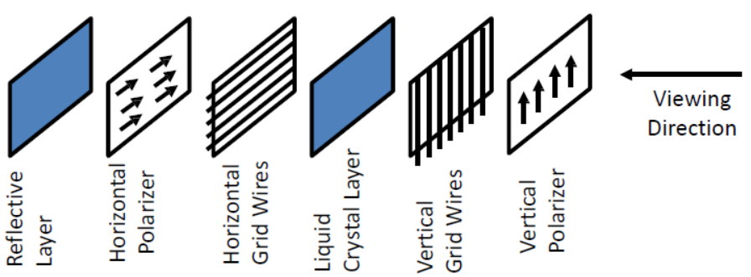
LCD Construction
Each pixel of an LCD consists of a layer of molecules aligned between two transparent electrodes, and two polarizing filters, whose axes are perpendicular.
Orientation of the liquid crystal molecules is determined by the alignment at the surfaces.
Six Layers:

Slide 35
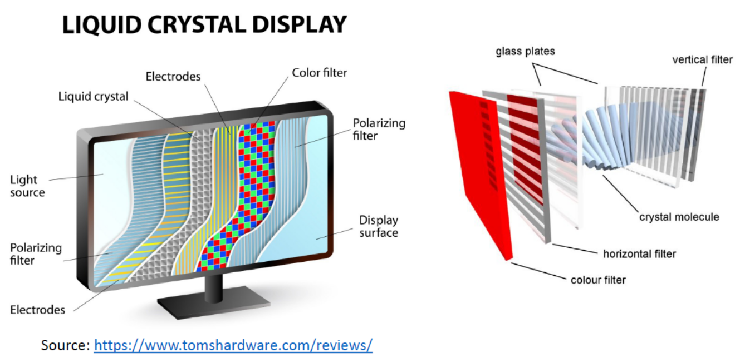

Slide 36
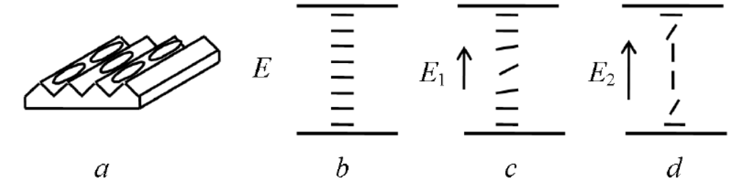
Basic Principle
Most of the LCDs use twisted nematic cells.
When a nematic liquid crystal material comes into contact with a solid surface molecules become aligned either perpendicular to the surface (homeotropic ordering) or parallel to the surface (homogeneous ordering).
These two forms can be produced by suitable treatment of the surface.
The most important electrical characteristic of liquid crystal materials is that the direction of the molecules can be controlled by the electric field. Usually the molecules tend to be orientated along the electric field.

Slide 37
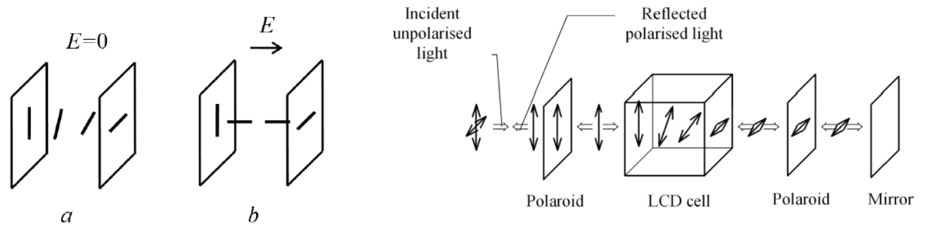
Basic Principle (2)
When a beam of polarised light is incident on the cell the liquid causes rotation of polarisation plane.
A strong enough electric field changes orientation of molecules and in this state the molecules have no effect on an incident light beam.

Slide 38
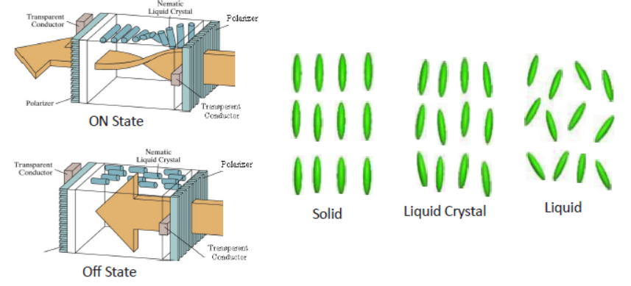
Characteristics

Slide 39
Working Principle of LCD
Before applying Electric field, the molecules arrange themselves in a helical structure, or twist.
When a voltage is applied across the electrodes, a torque acts to align the liquid crystal molecules parallel to the electric field, distorting the helical structure .
This reduces the rotation of the polarization of the incident light.
Classification of LCD:
Transmissive displays:
Transmission LCD displays do not have the reflector and must be provided with rear illumination. They operate in a very similar fashion to the reflective displays.
It is illuminated from the back by a backlight and viewed from the opposite side (front). Ex: Computer display.
Reflective displays:
It is illuminated by external light reflected by diffusing reflector behind the display. Ex: Calculator.

Slide 40
Applications, Advantages & Limitations of LCD
Applications:
LCDs with a small number of segments, are used in digital watches and pocket calculators, Small monochrome displays in personal organizers, or older laptop screens
High-resolution color displays such as modern LCD computer monitors and televisions;
Advantages:
An LCD cell consumes only microwatts of power over a thousand times less than LED displays.
LCDs can operate on voltages as low as 2 to 3 V and are easily driven by MOS IC drivers.
Limitations:
They cannot be seen in the dark,
They have a limited viewing angle;
They can be operated in limited temperature range.

Slide 41
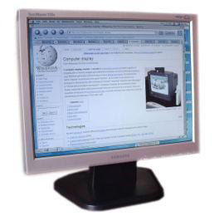
Thin Film Transistor (TFT) Technology
Normal LCDs like those found in calculators have direct driven image elements – a voltage can be applied across one segment without interfering with other segments of the display.
This is impractical for a large display with a large number of picture elements (pixels), since it would require millions of connections - top and bottom connections for each one of the three colors (red, green and blue) of every pixel.
To avoid this issue, the pixels are addressed in rows and columns which reduce the connection count from millions to thousands.
The solution to the problem is to supply each pixel with its own transistor switch which allows each pixel to be individually controlled.
A thin film transistor (TFT) is a special kind of field effect transistor made by depositing thin films for the metallic contacts, semiconductor active layer, and dielectric layer.
TFT-LCD (Thin Film Transistor Liquid Crystal Display) is a variant of liquid crystal display (LCD) which uses thin film transistor (TFT) technology to improve image quality.
TFT LCD is one type of active matrix LCD. It is usually synonymous with LCD.
It is used in both flat panel displays and projectors.

Slide 42
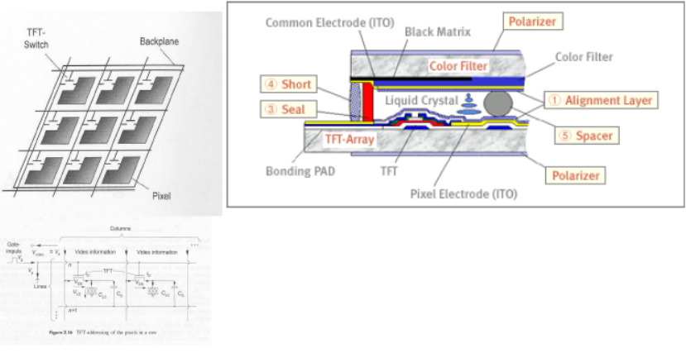
TFT-LCD

Slide 43
Construction of TFT Displays
Material:
TFTs are Metal-Insulator-Semiconductor Field Effect Transistors, which are used more often as bottom-gate.
Indium tin oxide (ITO) is usually employed for the electrodes.
Most TFTs are not transparent themselves, since many of them are based on hydrogenated amorphous silicon (A-Si:H) (A-Si, used as Gate-dielectric) have Low mask count; Small number of mask alignments and requires less processing steps).
The bandgap od S-Si is assumed to be less than that of crystalline silicon (1.12eV).
Construction:
A transistor switch which allows each pixel be individually controlled.
Each pixel is a small capacitor with a transparent ITO [indium tin oxide ]layer at the front, a transparent layer at the back, and a layer of insulating liquid crystal between (refer to figure in previous slide).
All the pixels in one row are driven with a positive voltage and all the pixels in one column are driven with a negative voltage.

Slide 44
Advantages and Disadvantages of TFT
Advantages:
Fast response time has been a great feature of TN (twisted nematics) displays.
Lower cost of production
Less noise or glitter seen on the panel surface
Disadvantages:
The TFT display suffers from limited viewing angles, especially in the vertical direction.
They are unable to display the full 16.7 million colors (24-bit true color) available from modern graphics cards.

Slide 45
Plasma Display
A plasma display panel (PDP) is a type of flat panel display, suitable and now commonly used for large TV displays (typically above 37-inch or 940 mm.
Construction:
The xenon and neon gas in a plasma television is contained in hundreds of thousands of tiny cells positioned between two plates of glass.
Long electrodes are also sandwiched between the glass plates, in front of and behind the cells.
Cell are covered with a magnesium oxide protective layer.

Slide 46
Working of PDP
Control circuitry charges the electrodes that cross paths at cell,
This creates a voltage difference between front and back and causing the gas to ionize and form a plasma.
As the gas ions rush to the electrodes and collide, photons are emitted.
In color panels, the back of each cell is coated with a phosphor. The ultraviolet photons emitted by the plasma excite these phosphors to give off colored light.
The display panel is only about 6 cm (2½ inches) thick, and total thickness less than 10 cm.
They can be produce fairly large sizes, up to 262 cm (103 inches) diagonally.
Bright scenes (say a football game) will draw significantly more power than darker scenes.
Limited life time: Their lifetime is estimated at 60,000 hours

Slide 47
Advantages and Disadvantages
Advantages:
Supports large displays ,up to 103 inches diagonally.
Overall thickness of monitor is less than 10 cm. and can be installed on a wall.
Faster response time, Greater color spectrum, Wider viewing angle
Disadvantages:
They are costly as compared to CRT, LCD displays.
Burn-in problem:
Static images can leave a permanent mark on screen. That is why they are not used in computer monitors and video game displays.

